Slide 1
Analysis of IPL {Indian Premier League}
By – Prashant Kumar
Course – Data Science
Date – 01/03/2025

Slide 2
Content
POWER BI DESKTOP TOOLS ARE USED.
DASHBOARD AGENDA
DASHBOARD PERFORMANCE
DASHBOARD SNIPPETS
SKILLS LEARNED
ACKNOWLEDGEMENT

Slide 3
POWER BI TOOLS ARE USED
Data Connectivity & Transformation
Power Query Editor – Used for data cleaning, transformation, and modeling.
Data Sources – Connect to various data sources like Excel, CSV etc.
DAX (Data Analysis Expressions) – Used for creating custom calculations, measures, and calculated columns.
Data Modeling & Relationships
Data Model View – Helps define relationships between different tables
Measures & Calculated Columns – Created using DAX for deeper insights.
Visualization Tools
Visualizations Pane – Includes bar charts, pie charts, maps, tables, KPIs, and more.
Slicers & Filters – Enable dynamic data filtering.

Slide 4
Dashboard agenda
What insights should the dashboard provide? (Team performance, player stats)
What data sources will be used? (CSV files).
How should team performance be compared across seasons?
How should batting and bowling statistics be represented?
What types of visualizations should be used? (Charts, Slicers, scorecards)
What calculated fields (DAX measures) are required?
Should we allow users to filter data? (By team, player, season, venue, match type)

Slide 5
DAShboard performance
Win/Loss Records: Numbers of matches won, lost, and tied.
Head-to-Head Record: Performance against specific teams.
Top Run Scorers: Leading batters based on total runs scored.
Strike Rate & Total Runs: Consistency and impact of batters.
Most Wickets: Bowlers with the highest wicket tally.
Economy Rate: Effectiveness of bowlers in restricting runs.
Toss & Match Result Correlation: Impact of toss decisions on results.
Orange Cap & Purple Cap Holder

Slide 6
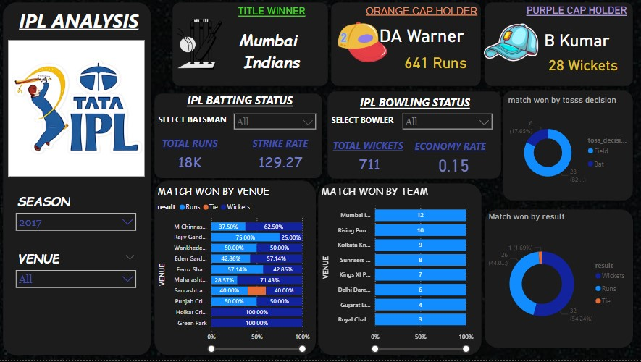
Dashboard Snippets

Slide 7
Skills learned
Data Extraction: Importing data from Excel, CSV etc.
Data cleaning & Transformation: Handling missing values, duplicates, and data formatting using power query editor.
Data Merging & Relationships: Connecting tables with one-to-many and many-to-many relationship.
DAX Functions: Calculate, Sumx, Average etc.
Data Visualization: Using cards, Bar charts, pie charts, donut chart etc.
Top run scorers, wicket-takers, strike-rate, economy-rate etc.
Team performance trends across different seasons and venues.

Slide 8
acknowledgement
I WOULD LIKE TO EXPRESS MY SPECIAL THANK TO MY TEACHER ‘MR. DIVAKAR KUSHWAHA SIR’ AT DUCAT IT TRAINING SCHOOL FOR THEIR INVALUABLE GUIDANCE, INSIGHTFUL MATTERSHIP THROUGHOUT THE POWER BI COURSE TO PRESENT THIS PROJECT TITLE – ANALYSIS OF IPL (Indian Premier League) DASHBOARD WITH THE UTMOST KNOWLEDGE. THEY DEDICATION TO TEACHING AND THEIR ABILITY TO SIMPLIFY COMPLEX CONCEPTS IN HELPING ME TO DEVELOP MY SKILLS.

Slide 9
Thank you

